Slide 1



What’s new in Angular
2016-12-08
Stephen Fluin
Kara Erickson

Slide 2

Angular 1.x

Slide 3
Angular

Slide 4

Component Architecture

Slide 5
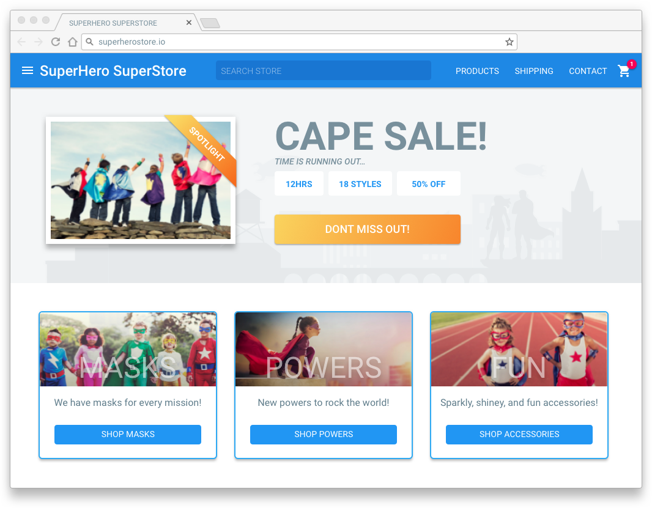



Application Composition
NAV COMPONENT
SALE COMPONENT
PRODUCT COMPONENTS
APP COMPONENT

Slide 6



Application Composition
PRODUCT COMPONENT
BUTTON COMPONENT

Slide 7
Application Composition
NAV COMPONENT
SALE COMPONENT
PRODUCT COMPONENTS
BUTTON COMPONENTS
APP COMPONENT

Slide 8

Components
=
HTML
< >
+
CSS
[ ]
+
Class
{ }

Slide 9

Templates
Standard HTML
HTML
app/hero-list.component.html
<h2>Hero List</h2>
<p><em>Pick a hero from the list</em></p>
<ul>
<li *ngFor="let hero of heroes" (click)="selectHero(hero)">
{{hero.name}}
</li>
</ul>
<hero-detail *ngIf="selectedHero" [hero]="selectedHero></hero-detail>
Angular 2 Templates: Will It Parse?

Slide 10


Templates
{{expression}}
HTML
Interpolation
[propertyName] = “expression”
Property & Event Binding
One Way Binding
(eventName) = “statement”
Event Binding
Component
DOM
[(ngModel)] = “property”
Two Way Binding
app/hero-list.component.html
…
<li *ngFor="let hero of heroes" (click)="selectHero(hero)">
{{hero.name}}
</li>
…
<hero-detail *ngIf="selectedHero" [hero]="selectedHero></hero-detail>

Slide 11
Templates
Structural
HTML
app/hero-list.component.html
…
<li *ngFor="let hero of heroes" (click)="selectHero(hero)">
{{hero.name}}
</li>
…
<hero-detail *ngIf="selectedHero" [hero]="selectedHero></hero-detail>
Property & Event Binding
Directives
Attribute
app/hero-detail.component.html
<input [(ngModel)]="hero.name">

Slide 12
Templates
app/hero-list.component.html
HTML
<h2>Hero List</h2>
<p><em>Pick a hero from the list</em></p>
<ul>
<li *ngFor="let hero of heroes" (click)="selectHero(hero)">
{{hero.name}}
</li>
</ul>
Property & Event Binding
Component Class
Directives
app/hero-list.component.ts
Component
export class HeroListComponent implements OnInit {
heroes: Hero[];
selectedHero: Hero;
constructor (private service: HeroService) { }
ngOnInit() {
this.heroes = this.service.getHeroes();
}
selectHero(hero: Hero) { this.selectedHero = hero; }
}

Slide 13
Component Architecture
Just A Class
Service Composition
app/hero.service.ts
@Injectable()
export class HeroService {
constructor (
private http: Http,
private errorHandler: HttpErrorHandler) { }
getHeroes () {
return this.http.get('app/heroes')
.map(res => res.json().data)
.catch(this.errorHandler.handle);
}
}

Slide 14

Component Architecture
Service Composition
Injector
Dependency Injection
CrisisService
HeroService
PowerService
VillianService
app/hero-list.component.html
constructor(
private heroService: HeroService
) { }

Slide 15
Component Architecture
Service Composition
Injector
Dependency Injection
CrisisService
HeroService
PowerService
VillianService
app/hero-list.component.html
constructor(
private heroService: HeroService
) { }

Slide 16
Component Architecture
Service Composition
Injector
Dependency Injection
CrisisService
HeroService
PowerService
VillianService
app/hero-list.component.html
constructor(
private heroService: HeroService,
private powerService: PowerService
) { }

Slide 17
Component Architecture
Service Composition
app/app.module.ts
@NgModule({
imports: [
RouterModule.forRoot([
{ path: 'crisis-center', component: CrisisListComponent },
{ path: 'heroes', component: HeroListComponent }
])
…
],
…
};
Dependency Injection
Routing

Slide 18
Component Architecture
Service Composition
app/app.component.ts
import { Component } from '@angular/core';
@Component({
selector: 'my-app',
template: `
<h1>Angular Router</h1>
<nav>
<a routerLink="/crisis-center">Crisis Center</a>
<a routerLink="/heroes">Heroes</a>
</nav>
<router-outlet></router-outlet>
`
})
export class AppComponent {}
Dependency Injection
Routing

Slide 19
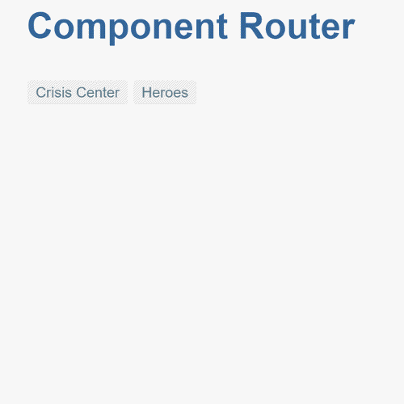
Component Architecture
Service Composition
Dependency Injection
Routing

Slide 20

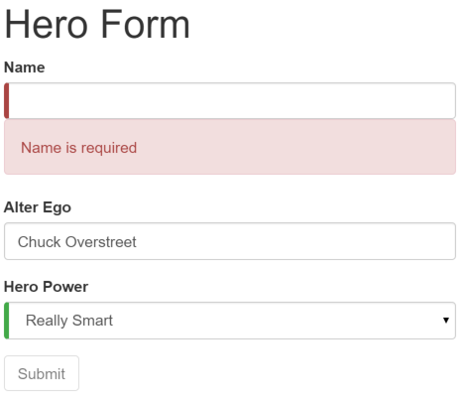

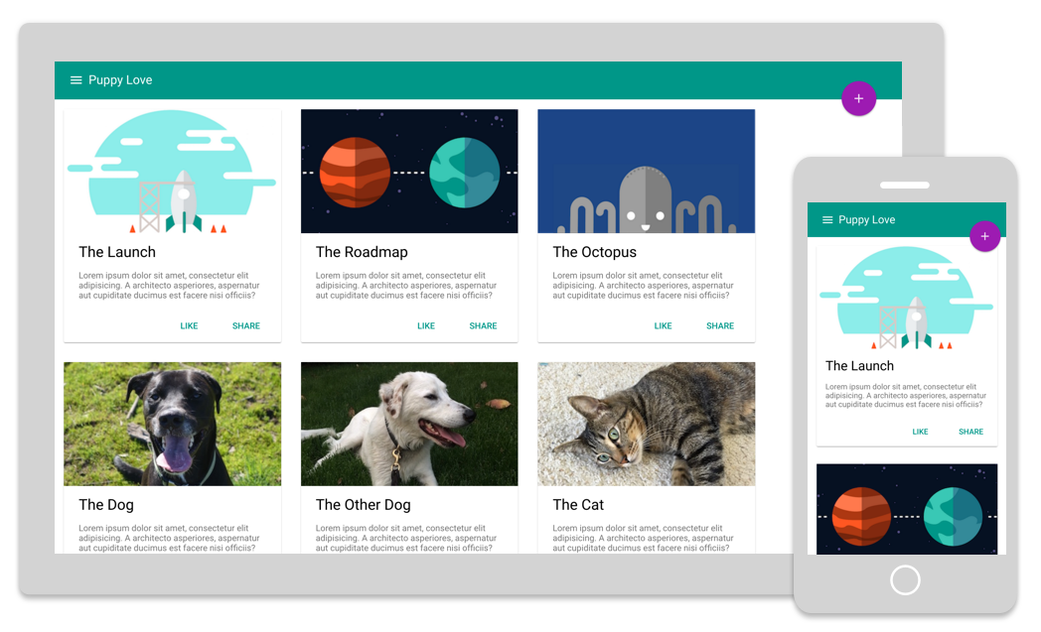


Angular Platform
Angular Material
Top Nav
i18n
Forms
Left
Nav
Main View
Animations
ngUpgrade

Slide 21

Angular Everywhere

Slide 22




Scenarios
PWA
Progressive Web Apps
Mobile
Desktop

Slide 23
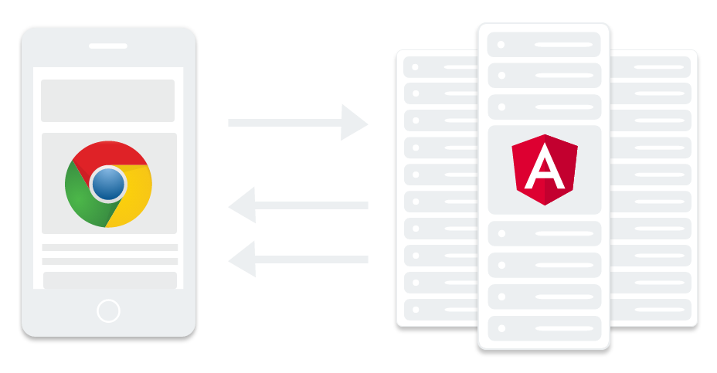
Server Scenarios

Slide 24


Server Scenarios

Slide 25

TypeScript
Superset of Javascript
Because Types!!
Readability
Familiarity
Tooling

Slide 26
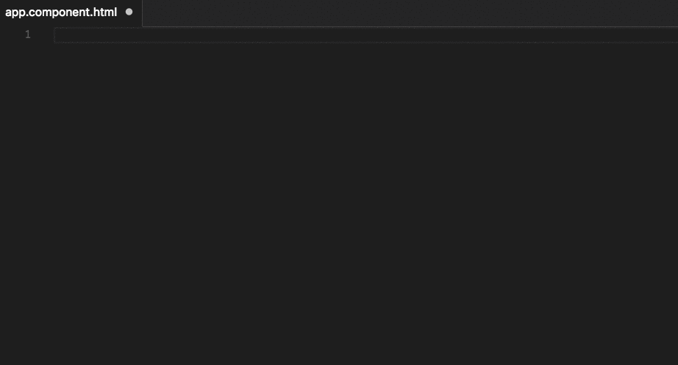
Language Services

Slide 27
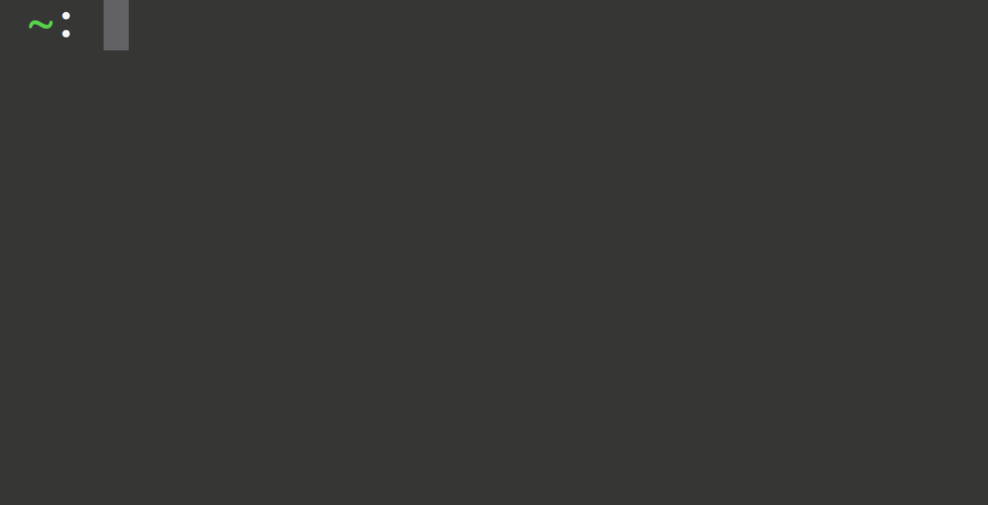
Angular CLI

Slide 28
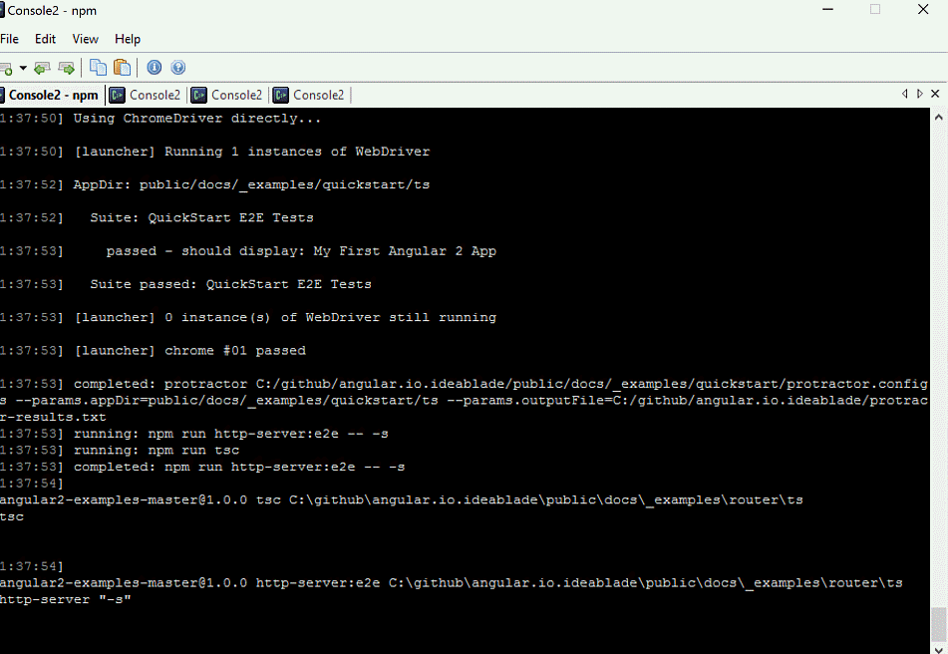
Protractor

Slide 29
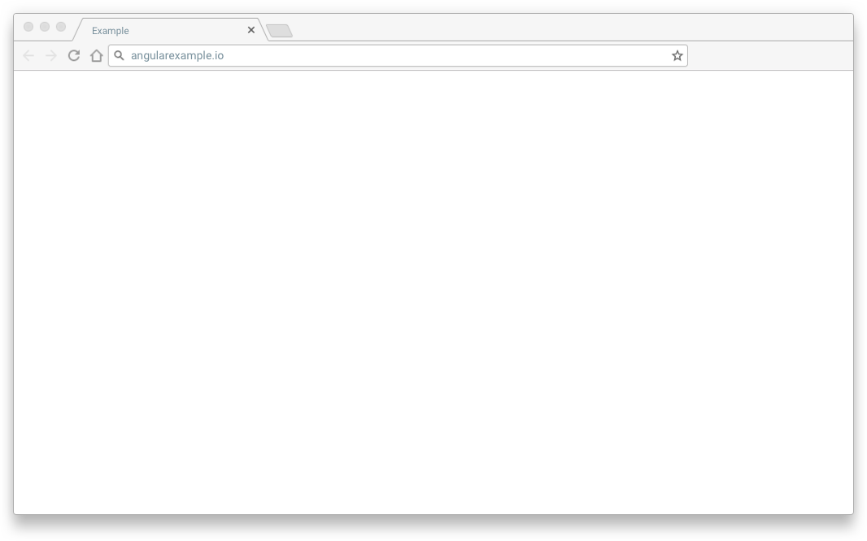
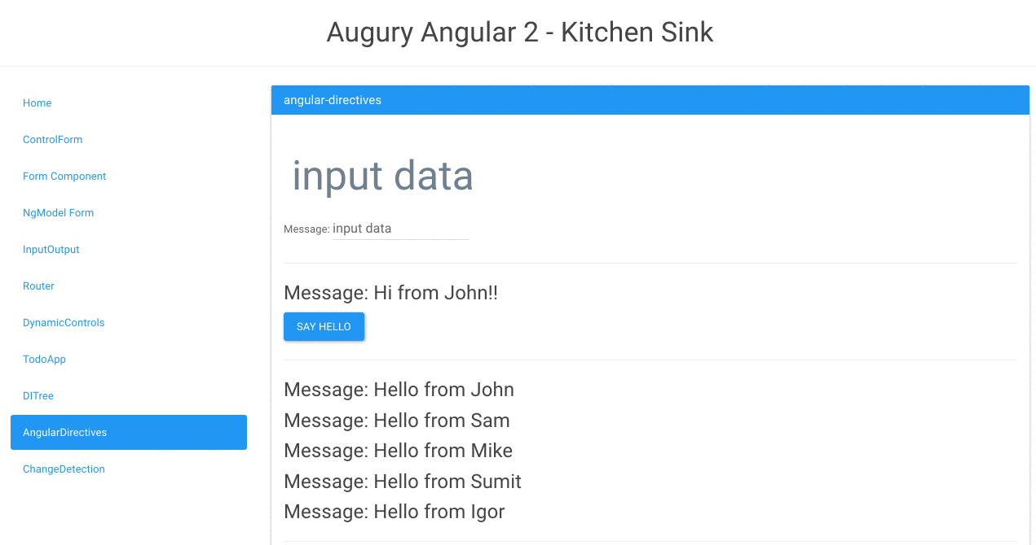
Angular Augury

Slide 30
Material Design Components
material.angular.io

Slide 31
Live Coding Demo
Kara Erickson

Slide 32
Performance

Slide 33
Performance
SIZE
SPEED
Smaller
Execute Faster
Do Less
Lazy
Memory Pressure
More...

Slide 34
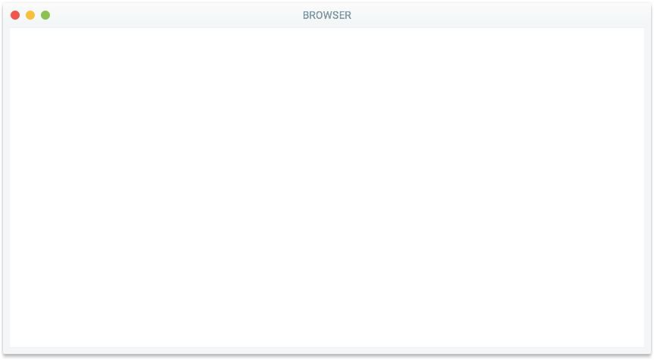
Angular 1: Interpreted Templates
HTML
Template Compiler
Change Detection
Renderer
CSS
JavaScript
DI Runtime
Change detection Runtime
View Runtime

Slide 35
Angular 2: Compiler Generates Code
HTML
Compiler
Views
CSS
JavaScript

Slide 36
Just In Time (JIT) Compilation
HTML
JIT
Compiler
Views
CSS
JavaScript

Slide 37
Just In Time (JIT) Compilation
Optimized for JavaScript
Virtual Machines
Change detection
10x faster!

Slide 38
Angular 2 Compiler Perf Improvement
Deep tree benchmark
6
5.7
4.5
3
Ratio
1.5
1.5
1.0
0
By Hand
Angular 2
Angular 1

Slide 39
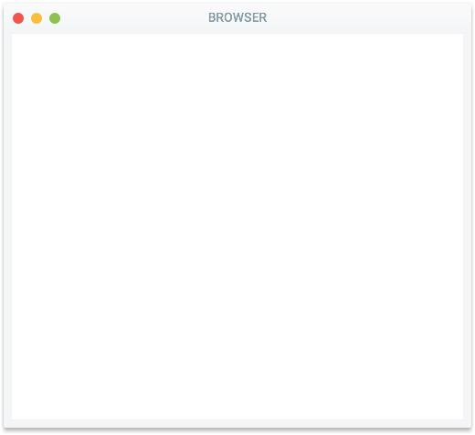
Ahead of Time (AOT) Compilation
Build Step
HTML
AOT Compiler
Views
CSS
JavaScript

Slide 40
Ahead of Time (AOT) Compilation
Optimized for JavaScript
Virtual Machines
No in-browser parsing
or compilation
Ship less code

Slide 41
JIT vs AOT Compilation - Page Load Performance
Deep tree benchmark
400
300
335
JIT
200
144
AOT
100
130
49
0
Load time (ms)
Size
(kb, gzipped)

Slide 42
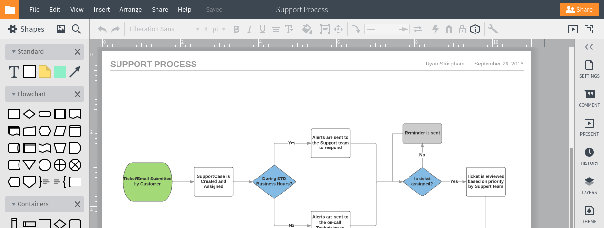
Lucidchart in Angular 2

Slide 43
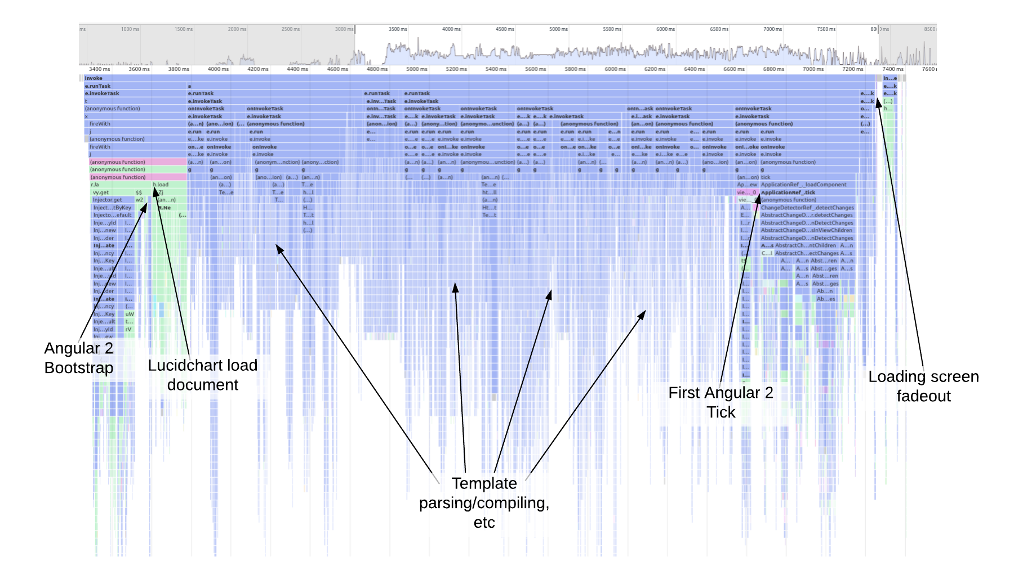
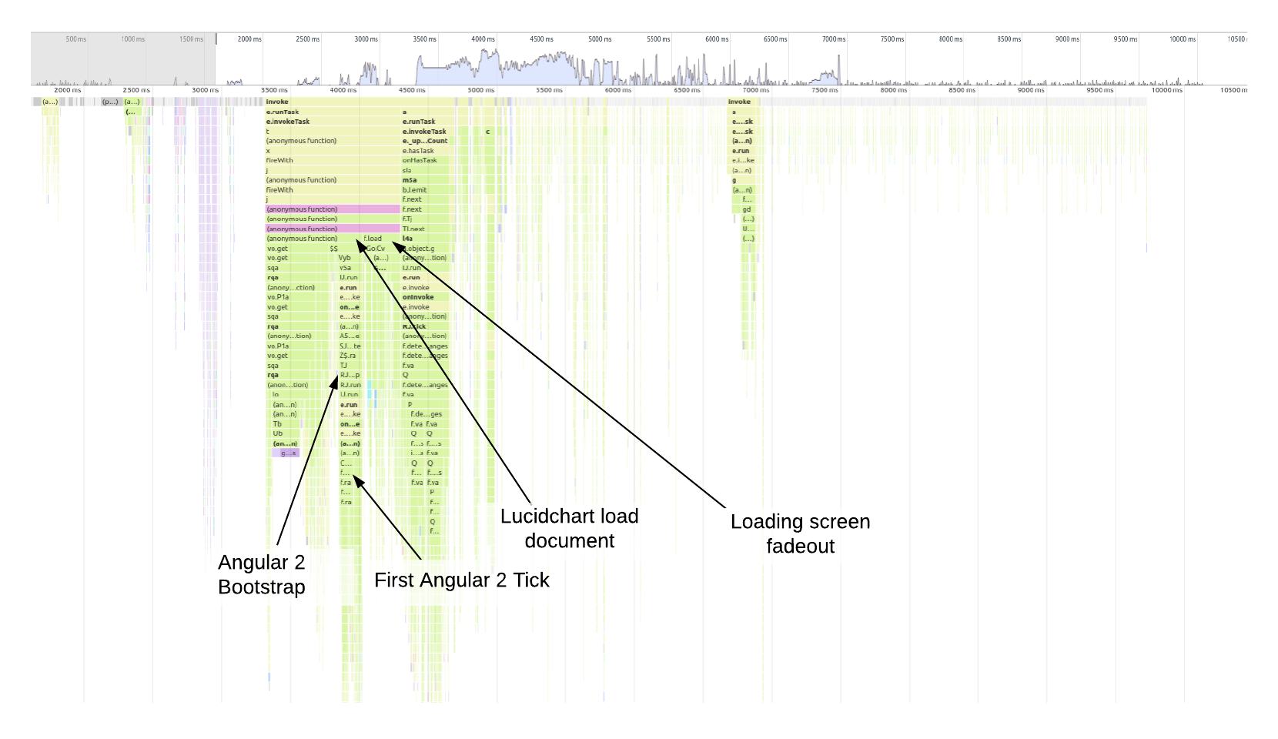
Lucidchart Bootstrap Case Study
JIT
AOT

Slide 44
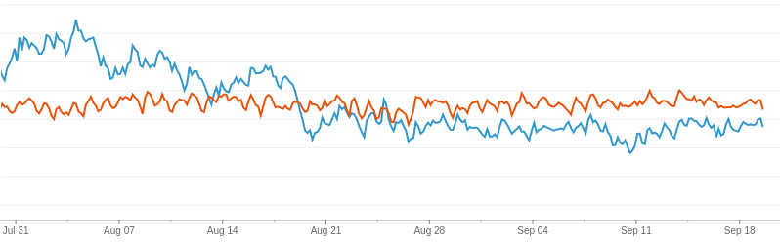
Ahead-of-time template compiler
AOT compiler
Angular 2 editor
Legacy editor

Slide 45
Ahead-of-time template compiler
AOT compiler
Closure advanced compilation
Angular 2 editor
Legacy editor

Slide 46
Ahead-of-time template compiler
27KB Hello World App!
AOT compiler
Closure advanced compilation
Angular 2 editor
Legacy editor

Slide 47
Lazy loading
Router
Lazy Loading
Boundary
Lazy Loading
Boundary
Component
Component
Element
Element
Element
Element

Slide 48
Change detection strategies
Always (default)
On Push
Detached

Slide 49
Yet more performance...
Web Workers

Slide 50
Yet more performance...
Web Workers
Service Workers

Slide 51
Yet more performance...
Web Workers
Service Workers
Faster Than Baseline

Slide 52

Yet more performance...
Web Workers
Service Workers
Faster Than Baseline
10K Hello World

Slide 53
Yet more performance...
Web Workers
Experimental
Service Workers
Experimental
Faster Than Baseline
In Development
10K Hello World
In Development

Slide 54
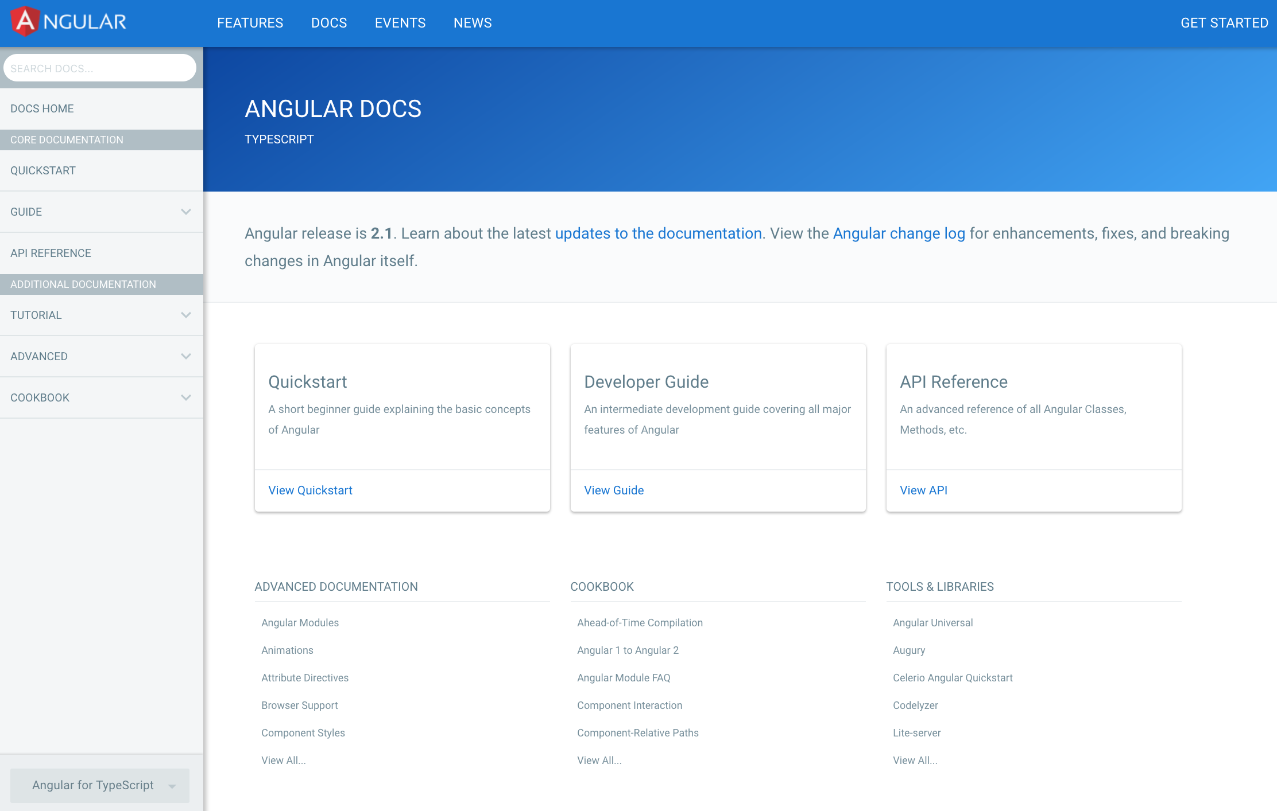
Documentation
Quickstart
Developer Guides
Cookbooks
API Reference

Slide 55
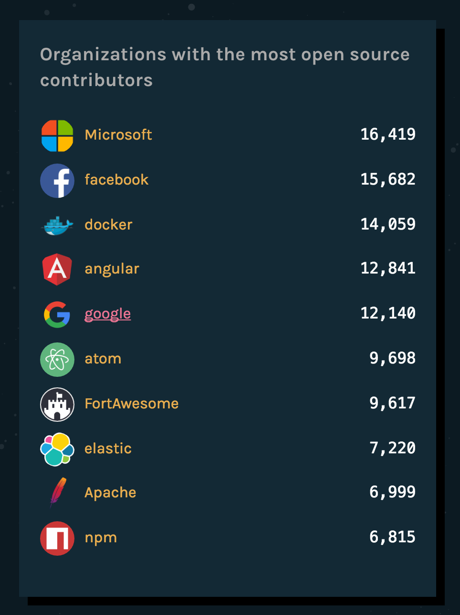
Community
1.2M
1
623k
0.5
0
Angular 1
Oct 2016
Angular 2
Oct 2016
Based on 30-day active visitors to Angular docs
Source: State of Octoverse 2016

Slide 56









































Ecosystem

Slide 57










Angular 2 In Production

Slide 59
Thank You
angular.cn
Stephen Fluin
Kara Erickson

